Slide 1


Delivering EVM Assessments
Dan Brigden, WHO HQ

Slide 2
EVM OVERVIEW
EVM is primarily an online solution (requires internet connection), although data-collection can operate both online and offline.
1
2
3
2
COUNTRY MANAGEMENT
DATA COLLECTION
GLOBAL ANALYSIS
DATA COLLECTION
EVM Assessment Manager
(website)
THE ADMINISTRATION TOOL
EVM Locations
(mobile app)
THE DATA-COLLECTION TOOL
EVM Global Dashboard
(website)
GLOBAL DATA ANALYSIS
EVM Locations
(mobile app)
THE DATA-COLLECTION TOOL
* All will be released in EN, FR, ES and more will come later, including RTL languages

Slide 3
EVM Assessment Manager
EVM ASSESSMENT MANAGER
An online tool for countries to manage their EVM assessments and related EVM information (country setup, users, dashboards, etc.).
Each country has a separate, private EVM portal hosted on the WHO website.
Incorporates EVMA1 Site Selection tool and Assistant Tool.
Assignment, distribution and collection of location questionnaires takes place electronically.
Detailed analysis of all location and assessment data is possible at any time.
Access to country data is managed by countries and is role-based.

Slide 4
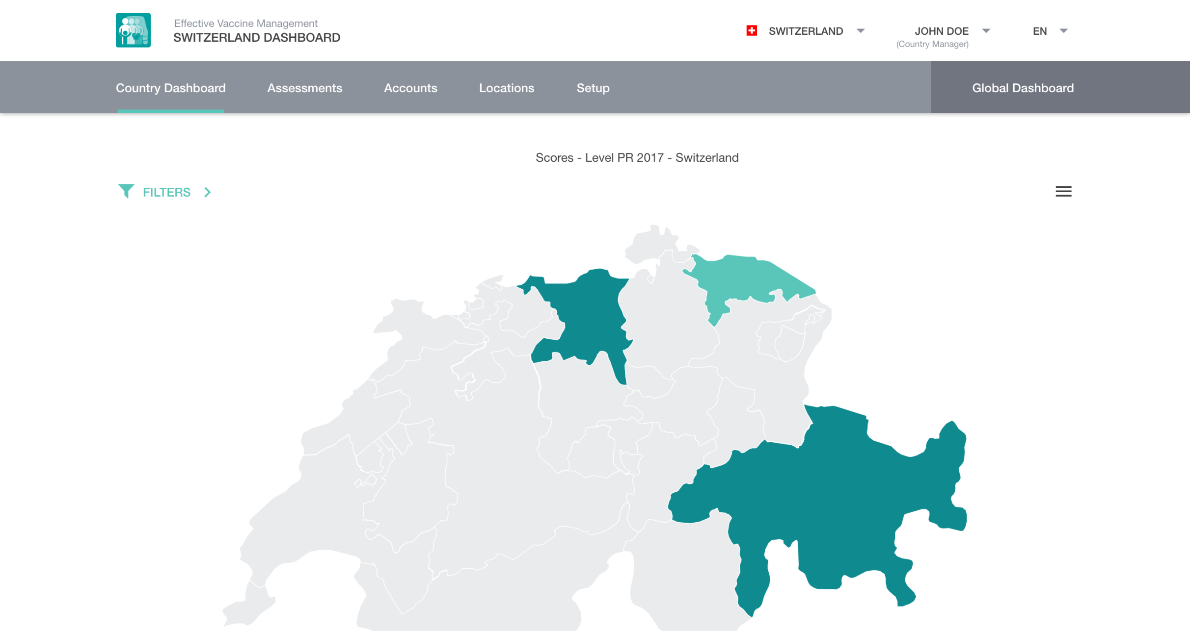
EVM ASSESSMENT MANAGER – WORKFLOW
SETUP
CREATE ASSESSMENT
FINALISE ASSESSMENT
Enter country-specific setup information
Complete assessment wizard
Complete program management questionnaire
Assign questionnaire to assessor(s)
Review submitted questionnaires
Complete and publish EVM assessment

Slide 5
EVM ASSESSMENT MANAGER – WORKFLOW
SETUP
CREATE ASSESSMENT
PUBLISH ASSESSMENT
Once the first assessment is created, subsequent assessments can be created very quickly as the country setup is in place.

Slide 6
EVM ASSESSMENT MANAGER – WORKFLOW
SETUP
CREATE ASSESSMENT
PUBLISH ASSESSMENT
S1 Vaccination schedule
S2 Supply chain parameters (nominal supply intervals, safety stocks, …)
S3 Tracer products
S4 Administrative units (state names, districts names, etc, and administrative relationships)
S5 Supply chain locations (vaccine stores and health facilities, and supply chain relationships)

Slide 7
EVM ASSESSMENT MANAGER – WORKFLOW
SETUP
CREATE ASSESSMENT
PUBLISH ASSESSMENT
Creating an EVM assessment:
  Complete the assessment wizard
  Create and assign location questionnaires to assessors or groups of assessors
  Assessors complete programme management questionnaire
  Manage questionnaires that have been completed and submitted by assessors

Slide 8

EVM ASSESSMENT MANAGER – WORKFLOW
SETUP
CREATE ASSESSMENT
PUBLISH ASSESSMENT

Slide 9
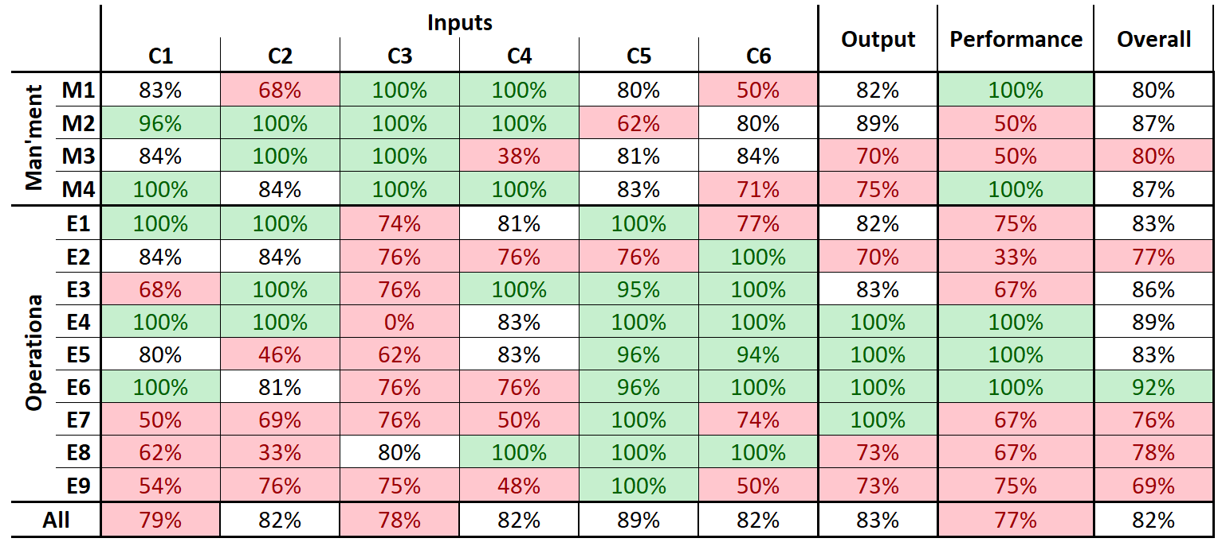
Country dashboard
EVM Assessment Manager will provide managers with access to all the reports in the app, as well as several additional ones with comparison features. Can compare across status (published compared with unpublished or incomplete, etc.).

Slide 10
EVM Global Dashboard

Slide 11
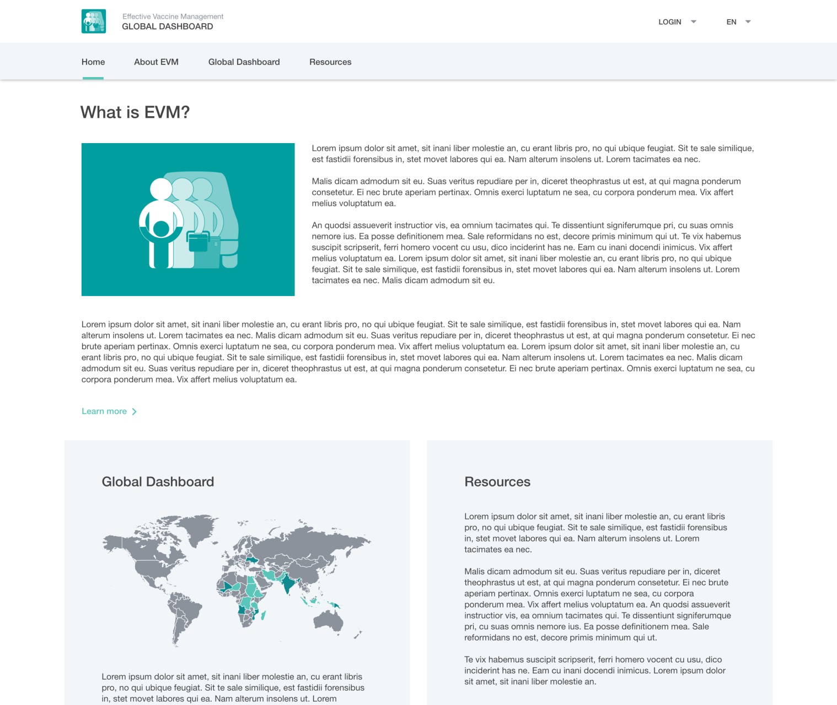
EVM website

Slide 12
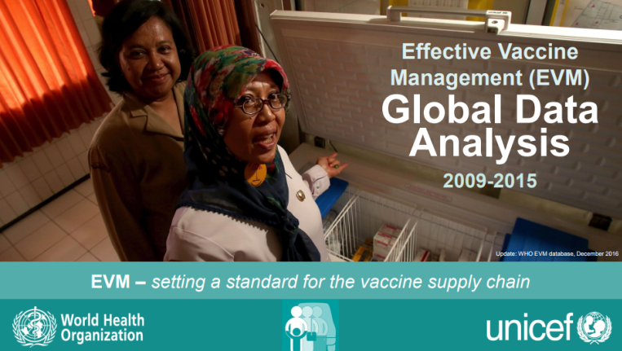
EVM Global Dashboard
Website hosted by WHO.
Provides a means of accessing and interpreting published EVM assessment scores at the global, regional and country level, basically an interactive version of the EVM Global Data Analysis PDF available on the WHO website.
Consists of dashboards that will enable visitors to generate live charts of published aggregated EVM assessment scores, using all assessment datasets uploaded and approved at that time.
Real-time data visibility for published EVM assessment data.

Slide 13
EVM Global Dashboard – data access
Unpublished EVM assessment data is not visible in the EVM Global Dashboard - only visible in the Assessment Manager for that country
Access to dashboards (for published EVM assessment scores only) is strictly determined by account permissions
  Aggregated (global/regional) dashboards - public access;
  Country-specific EVM assessment dashboards (EVM country scores) – country administrators only*
  Subnational EVM assessment dashboards - relevant country administrators only
Potentially also select country partners as requested.

Slide 14

Thank you

